Slide 1
Does advertising work?
How to measure the long-term impact of our marketing investments
Jeremy Horne
Warwick R User Group
10th June 2024
Your Data & Analytics Partner

Slide 2
Disclaimer…
I’m not going to tell you that all advertising DOES work or all advertising DOESN’T work as it’s clearly not a “one size fits all” approach!
Obviously IT DOES (broadly speaking)
The numbers you see here may not be the same for your brand, product and campaign.
I am a data scientist, not an advertiser or marketing expert.
Notes:
People wouldn’t pay me if it doesn’t work
Don’t quote my numbers as gospel to your boss and send the heavies next time
I can’t write your ads and I certainly can’t make a witty video!

Slide 3
Jeremy Horne
Founder & Director
Mathematician & Statistician
Data strategist and scientist
R lover
Mad cricket fan & bad gambler!
2020
2019
2017
2014
2005

Slide 4
Datacove are a Brighton based data & analytics consultancy
Customer analytics
We unearth your most valuable customers and tell you where you can find more of them.
Marketing analytics
We unlock insights and help maximise campaign performance.
Process automation
Taking your most time commanding tasks and automating them forever.
Notes:
People wouldn’t pay me if it doesn’t work
Don’t quote my numbers as gospel to your boss and send the heavies next time
I can’t write your ads and I certainly can’t make a witty video!

Slide 5
How do we plan advertising?

Slide 6
A joint project with marketing agency, December19

Slide 7
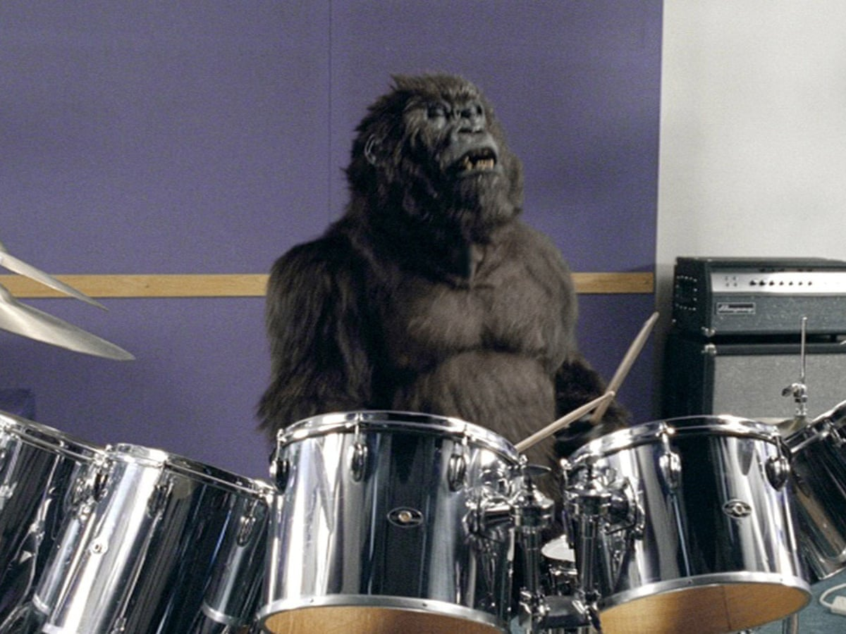
Most people think of creatives when it comes to advertising

Slide 8
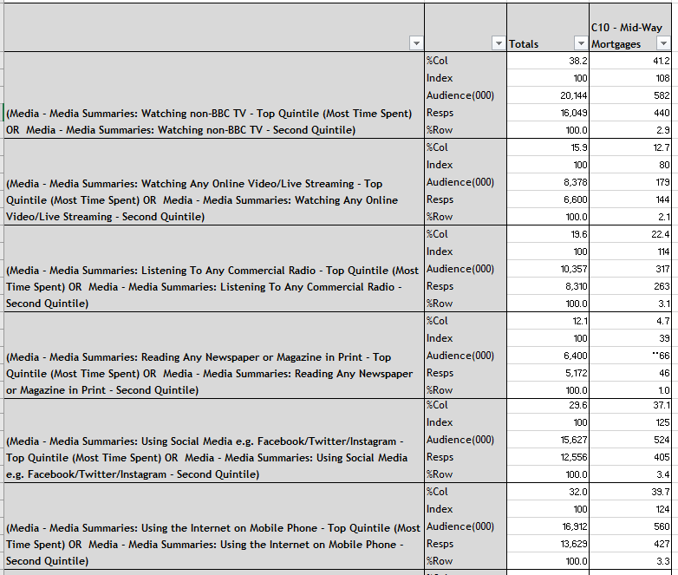
But media agencies are slightly different!

Slide 9
They are mostly linked with media to best reach an audience
Who are the target audience?
What message are we trying to convey?
What media channels to they most consume?
What is the most effective channel to deploy?

Slide 10
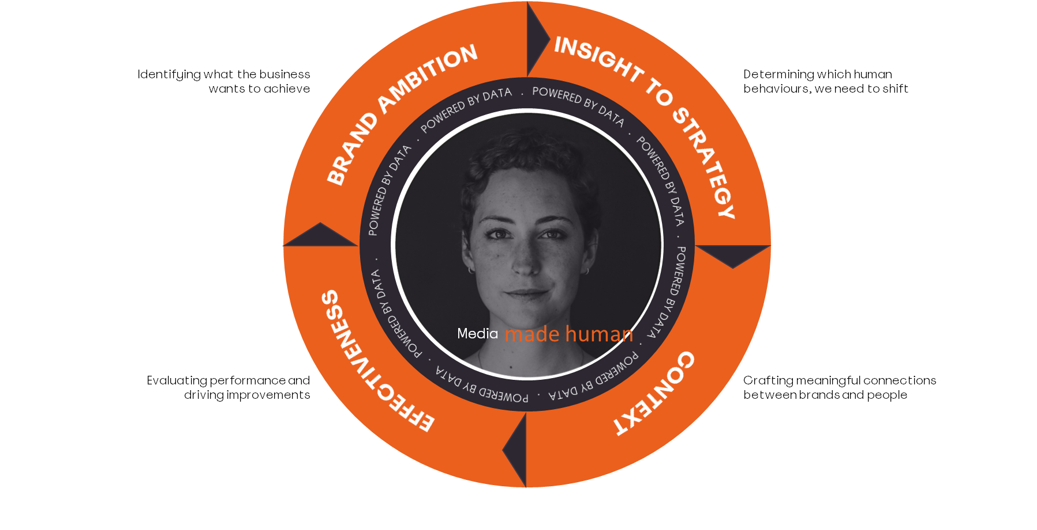
But understanding the impact of marketing is a key part

Slide 11
Measurement informs us of the levers to deliver on targets
Radio is excellent at increasing brand awareness
TV will drive a greater volume of sales
More spend in YouTube will lower our ROI
We can work to a guaranteed cost per click with Facebook

Slide 12
We have a plan… but how can we measure it?

Slide 14
Digital channels can be attributed
Who knows!!
So, which one is the best?

Slide 15
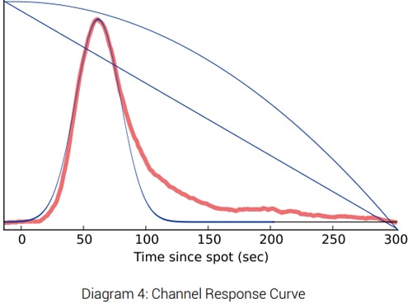
Offline channels can be measured using ‘spot’ matching
Non-digital channels (e.g. TV), don’t have nice buttons we can click on!
We need to look at immediate web / call centre response
Like digital models, these can only provide a short-term estimate

Slide 16
What about when online and offline combine to generate a sale?
Offline
Online
What about sales not driven by marketing
So, what can we do to overcome this?

Slide 17
Econometrics:
Measures the long term impact of all media and non-media activities on a specific business KPI (e.g. Sales)
What proportion of sales are driven by advertising?
What is the ROI of each advertising channel?
What’s the maximum I can spend before advertising becomes unprofitable
What happens if I stop advertising?

Slide 18
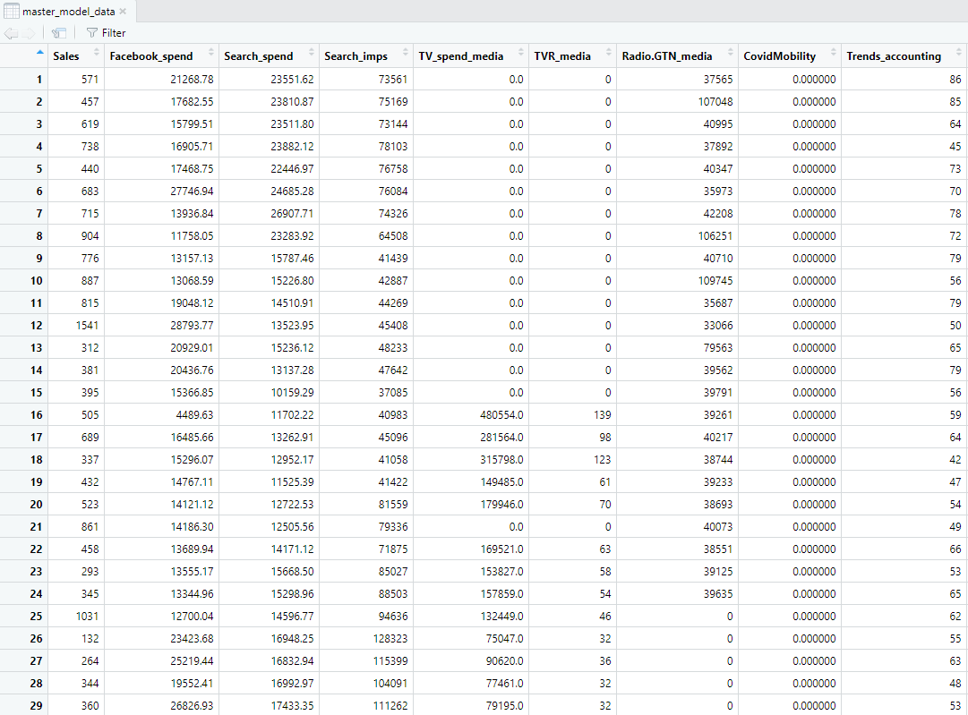
We carry this out in R

Slide 19
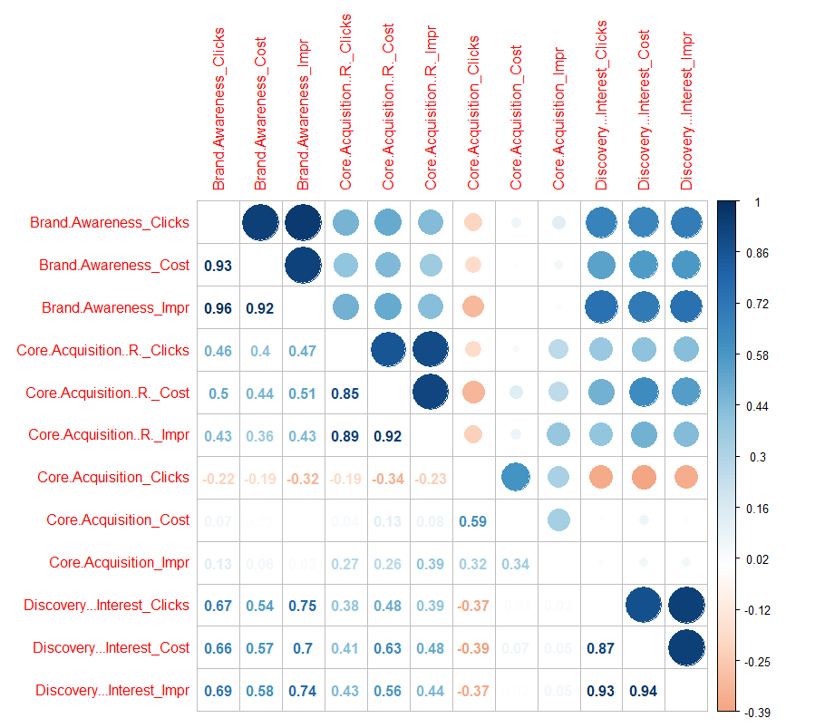
First, we need to get to know the data!
Sharp impression rises
However, Sales rise two weeks later

Slide 20
The model determines maximal spends and ‘stop’ effects
Maximal spend: ‘Diminishing returns’
Stop effect: ‘Adstock’

Slide 21
How does this work in practice?

Slide 22
Why we needed econometrics for Xero
Xero are an accounting & business software
Their sales can come from partner accountants and bookkeepers, as well as direct from business owners
There is rarely a straightforward attribution journey, how many people will see an advert and immediately change their accounting?
We needed to unpick the contribution of advertising

Slide 23
It first allowed us to understand the contribution of channels

Slide 24
More granularly, it teaches us the optimal weights for our channels
Optimal spend:
£X - £Y

Slide 25
Which leads to us improving performance over time
TV ROI increased by 37%
TV spend for most recent burst reduced in line with efficient weights

Slide 26
But also shows the importance of wider non-media factors

Slide 27
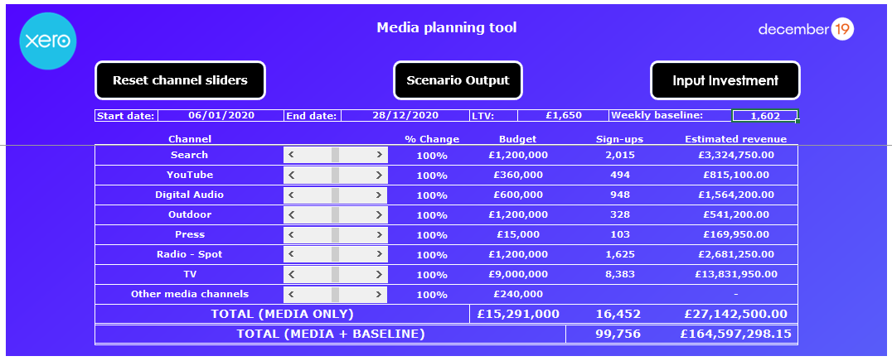
And provided a planning tool to forecast future delivery
XXX
XXX
XXX

Slide 28
Wait, so only big brands can use this?
Big consultancies will make you believe this costs £70K – it doesn’t
However, even a lite £10-15K model might be seen as expensive (it will pay for itself)
Datacove are currently partnering with academics / universities to develop a tool that makes this even more affordable to smaller brands

Slide 29
Summary and key takeaways

Slide 30
What should you tell your boss tomorrow morning?
Data analytics / data science shouldn’t be complicated – it’s just problem solving!
Digital attribution is becoming harder; offline attribution has always been hard – more robust methods are needed
Econometrics pays for itself – it tells you when to cut spending, when to stop spending and what the true value of your investments is
Marketing isn’t the only thing that impacts your KPIs – consider additional factors such as reviews, competitors – and politics!
Econometrics should be for everyone; not just the big brands

Slide 31
15% DISCOUNT IF YOU BUY FROM ME DIRECTLY TODAY!
EARL is BACK!
3ʳᵈ – 5ᵗʰ of September 2024
The Grand Hotel, Brighton
Join Your Community on EARLy Bird Prices
Student and Academic, Charity, Community and Government Discounts Available. Email here:
admin@datacove.co.uk
For more information and to secure your tickets scan here
Notes:
baby blues colour pallete

Slide 32
Our Keynote Speakers
Hadley Wickham
Christel Swift
Steph Locke
Prof Andy Field
Chief Data Scientist at
Posit
Senior Principal Data Scientist at the BBC
Technology leader with an AI & Entrepreneur background at
Microsoft
Author, Statistician and Lecturer at University of Sussex

Slide 33
Our Workshops
Andrie de Vries
Director of Product Strategy, Posit
Jaymin Mistry
Senior Data Scientist, Faculty.ai
Steph Locke Technology Leader, Microsoft
Dan Gibson
Founder,
Personify AI
An Introduction to Shiny for Python
Building Data Pipelines in Python
Azure for the R person: So you found yourself accidentally managing Azure environments!
An Introduction to RAG in Python

Slide 34
Follow Us!
Scan to keep up with our Meetup Groups, Training courses and much more!

Slide 35
Thank you, questions?
Contact Us →
Datacove
https://www.datacove.co.uk
Phone : 01273 011 838
Email : Jeremy.Horne@datacove.co.uk
Your Data & Analytics Partner

